Slide 1
Towards generic Visual-Inertial Odometry
Julian Surber
Semester Thesis
Supervised by Margarita Chli & Lucas Pinto Teixeira

Slide 2
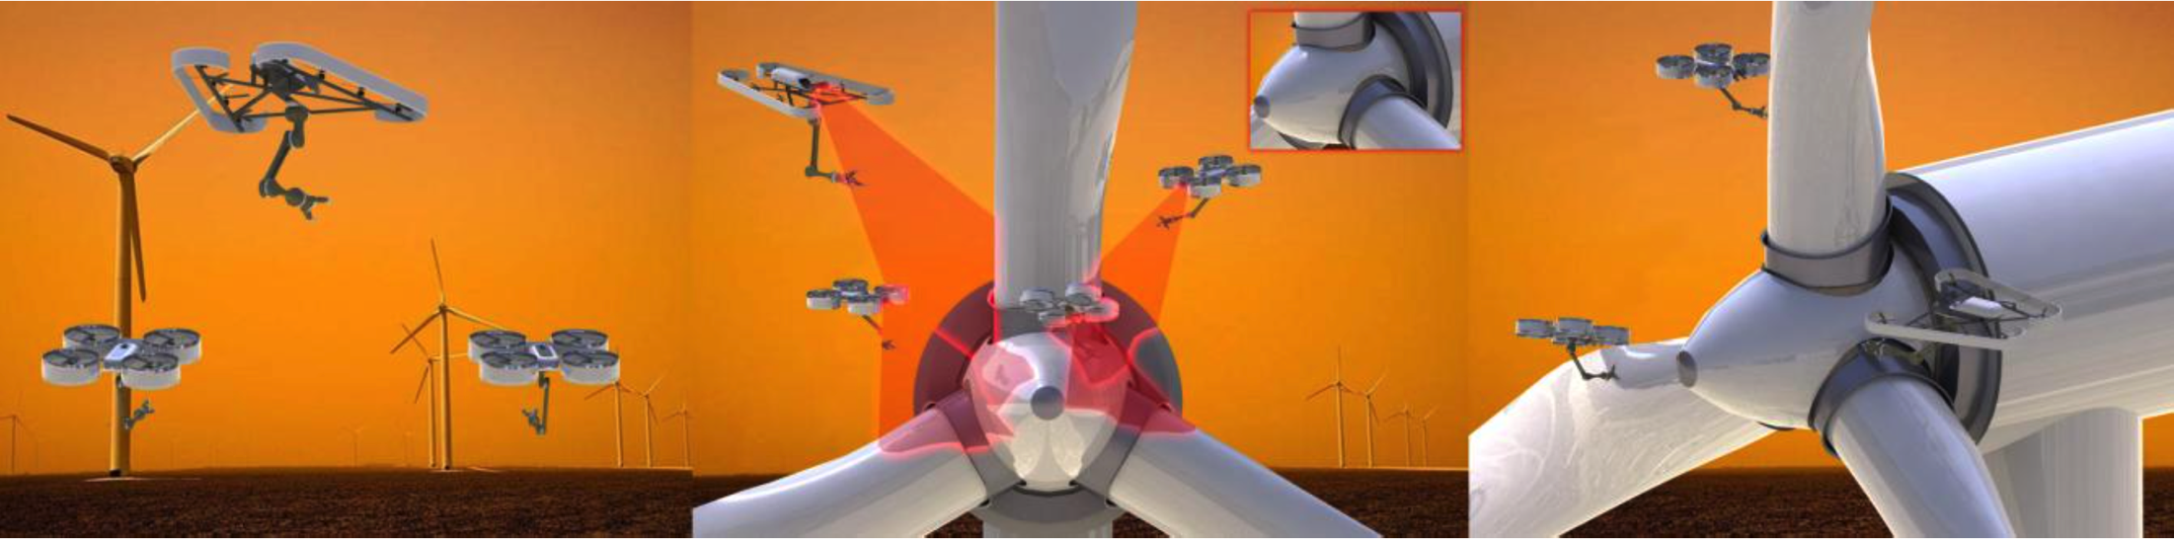
One key challenge: Single Robot Localization
Global and Local
Visual-Inertial Odometry
Complementary Properties
Lightweight
Passive
Onboard

Slide 3
ROVIO and OKVIS
Time-Synchronization
Outlook

Slide 4
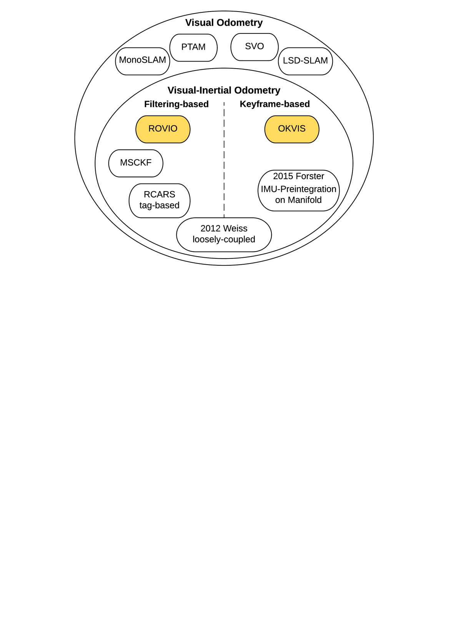
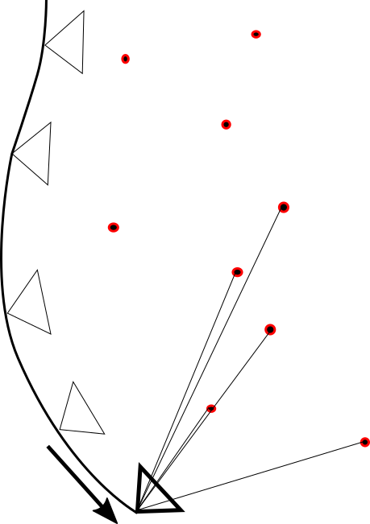
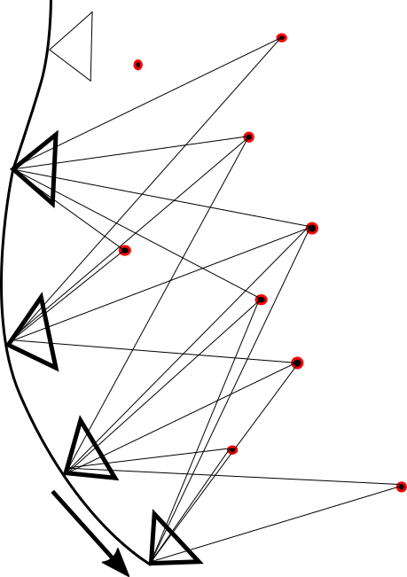
Overview
ROVIO and OKVIS
Time-Synchronization
Outlook
¹
²
¹ [Blösch et al., IROS, 2015]
² [Leutenegger et al., IJRR, 2015]
Notes:
Filtering-based: 2 steps ...
The information of a past observation is transferred into the Current Frame via the Prior Belief of the Filter.
But a Past Estimate will never be corrected based on the current observation.
Keyframe-based: nonlinear optimization based on a large number of landmark observations taken from a SET of past keyframes and the current frame.
Like that poses of the past are corrected based on the current observation.
ROVIO and OKVIS

Slide 5
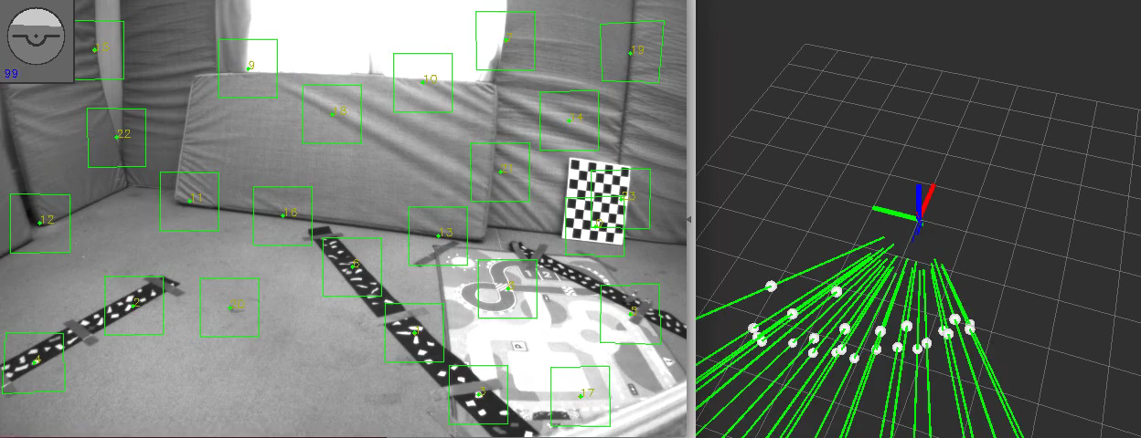
ROVIO – Robust Visual Inertial Odometry Using a Direct EKF-Based Approach
ROVIO and OKVIS
Time-Synchronization
Outlook
Fast Corner Detector / Multilevel Direct Intensity Patch Features

Slide 6
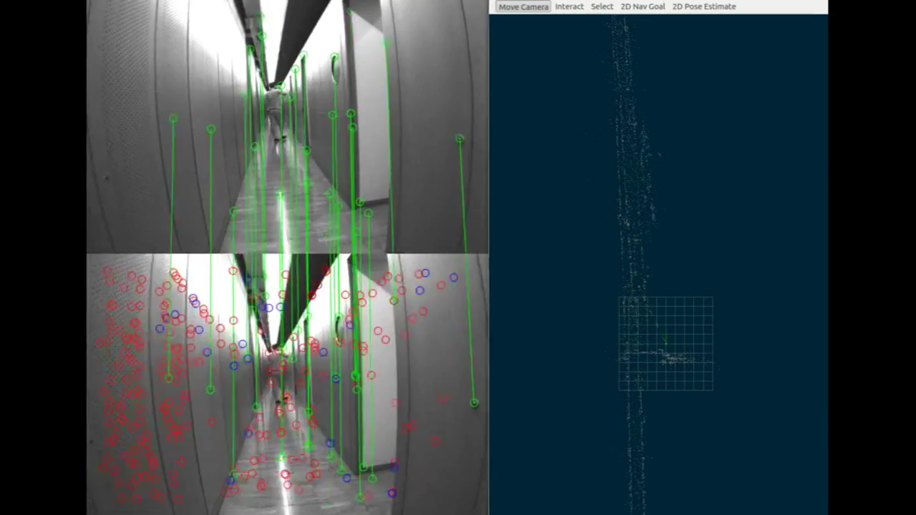
OKVIS – Optimal Keyframe-Based VI SLAM
ROVIO and OKVIS
Time-Synchronization
Outlook
[Leutenegger et al.,
IJRR, 2015]
Harris Corner Detector / BRISK Descriptor
Nonlinear Optimization

Slide 7
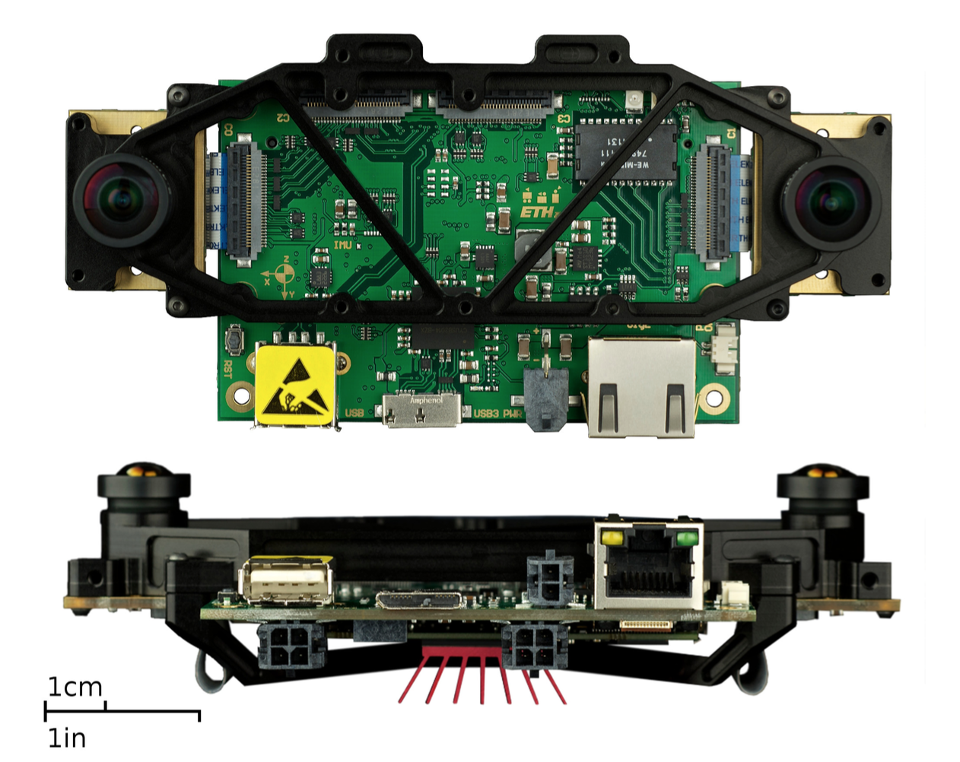
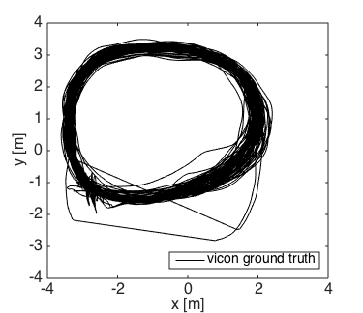
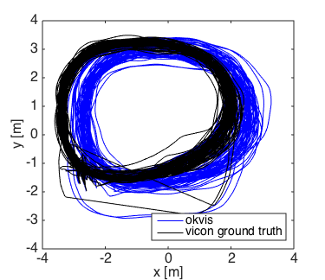
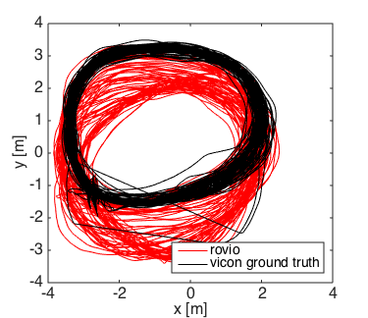
Comparison
ROVIO and OKVIS
Time-Synchronization
Outlook
Start /
Endpoint
[Nikolic et al., ICRA, 2014]
VI Sensor
Distance 1200 m, handheld, 100 Loops
Dynamics: 2 m/s, 3 rad/s
Notes:
I want to compare the two presented algorithms on a dataset Simon Lynen collected to evaluate OKVIS.
long trajectory captured indoors, 100 handheld loops
It is not clear out of this graph, but what happened was

Slide 8
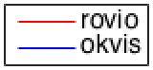
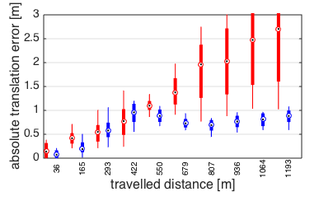
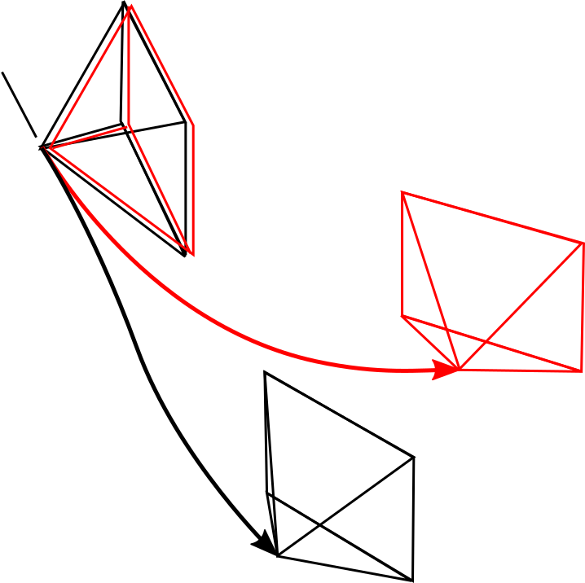
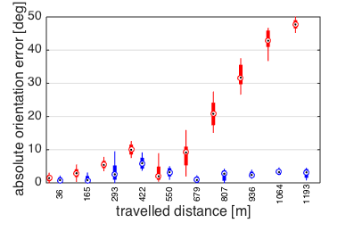
Global Accuracy
ROVIO and OKVIS
Time-Synchronization
Outlook
Notes:
If you look at the orientation error at the axes separately, the roll and pitch errors are bounded and below 1 degree for both algorithms over the whole sequence. Thanks to the IMU the gravity vector is observable and therefore errors around axes lying in the horizontal plane are bounded.
The major contribution to the absolute orientation error is coming from the yaw error – the rotation around the world-z axis.

Slide 9
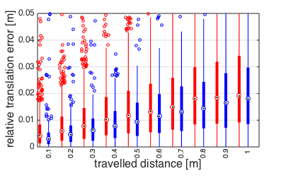
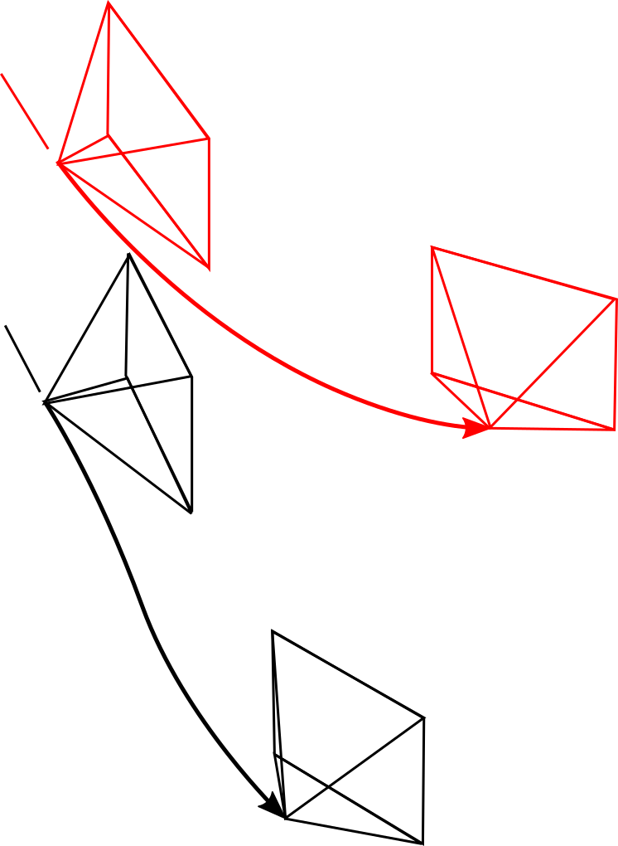
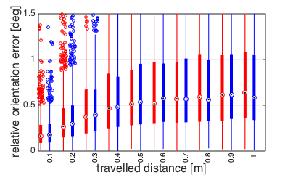
Local Accuracy
ROVIO and OKVIS
Time-Synchronization
Outlook
Notes:
In addition to the Global Accuracy it is of great interest how well tracking is working on short distances.
The relative translation error compares the true and estimated Travelled Distance between two frames.

Slide 10
Results
ROVIO and OKVIS
Time-Synchronization
Outlook
Absolute Error
ROVIO | OKVIS
2.5 m / 1000 m | 1 m / 1000 m
45 ° / 1000 m | 4 ° / 1000 m
Relative Error
ROVIO | OKVIS
2 cm / 1 m | 2 cm / 1 m
0.6 ° / 1 m | 0.6 ° / 1 m
Computational Complexity
ROVIO | OKVIS
10 ms / Frame | unknown, higher
Notes:
Gap in Global Accuracy
Similar Local Accuracy
Regarding Computational Complexity ROVIO is
Beside of these results there is an additional “soft” argument for Rovio: It is working robustly for many people in here – live with the visensor, in simulation and on other different datasets I was working on.

Slide 11
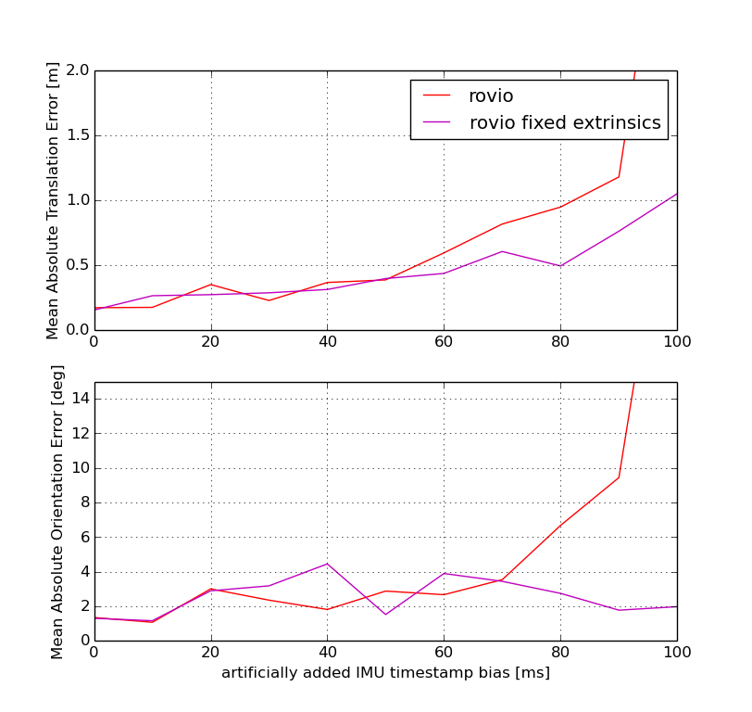
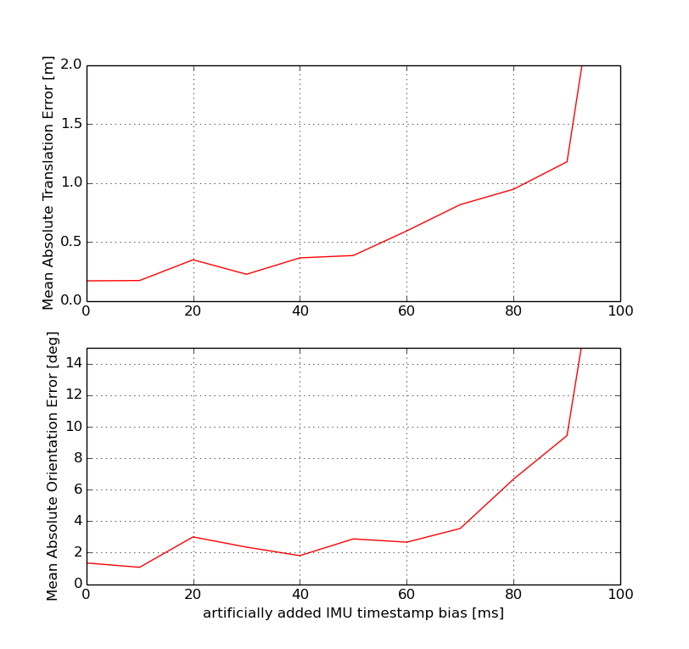
Towards non-timesynchronized Hardware
ROVIO and OKVIS
Time-Synchronization
Outlook
1) Analysis with artificial bias on IMU timestamp
Notes:
Go over to the second part, where I takle the question if Visual-Inertial Odometry is able to work with data from non-timesynchronized Hardware.
The VI SENSOR is hardwarewise timesynchronized, which means that the IMU is triggering the image capture and the sensor signals arrive perfectly time-aligned.
As a first analysis I took data from the visensor and added an artifical bias on the IMU timestamp
1) For this data: ROVIO is surprisingly robust untill 50 ms, DIVERGING at 100ms
2) A second result ...
Normally Rovio is estimating the camera-IMU extrinsics constantly

Slide 12
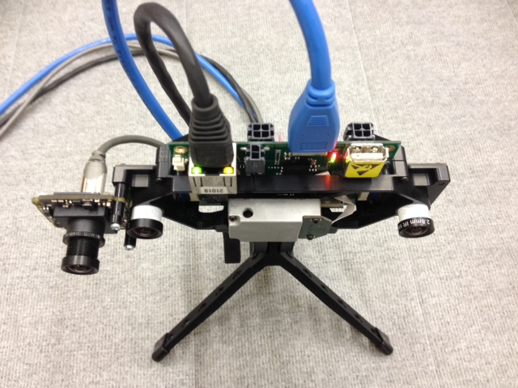
Towards non-timesynchronized Hardware 2) Real Test
ROVIO and OKVIS
Time-Synchronization
Outlook
VI Sensor
Bluefox 2.0
Indoor, handheld, 60 m, 3 loops
Slow and Fast Dataset
Notes:
This analysis encouraged us ...

Slide 13
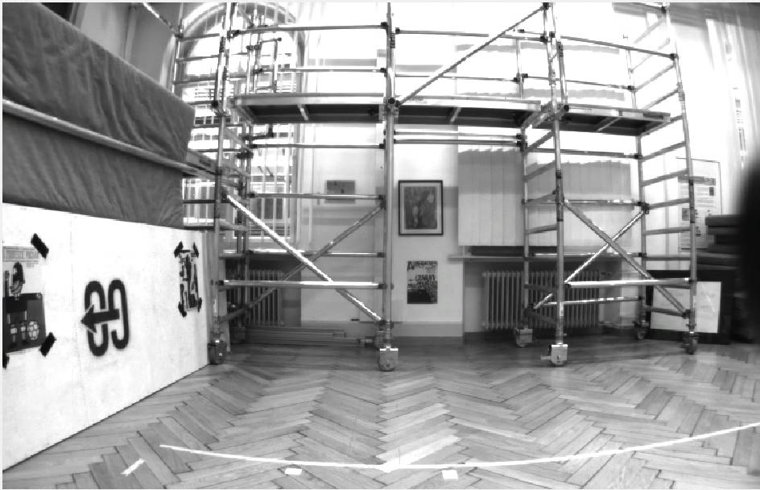
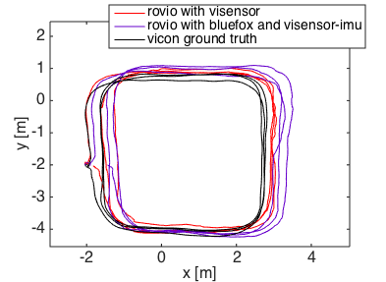
Slow Dataset
ROVIO and OKVIS
Time-Synchronization
Outlook
Dynamics: 1.5 m/s, 1 rad/s
Non-timesynchronized Hardware is able to track
Visensor performs better

Slide 14
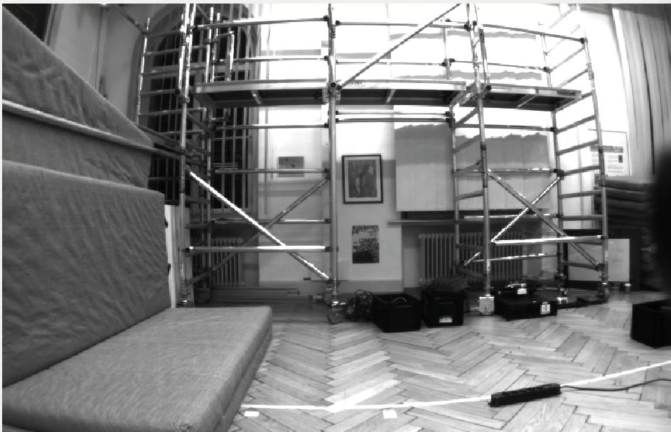
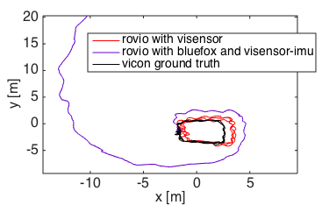
Fast dataset
ROVIO and OKVIS
Time-Synchronization
Outlook
Fast, shaky motions
Dynamics: 2.5 m/s, 5 rad/s
Non-timesynchronized Hardware diverging

Slide 15
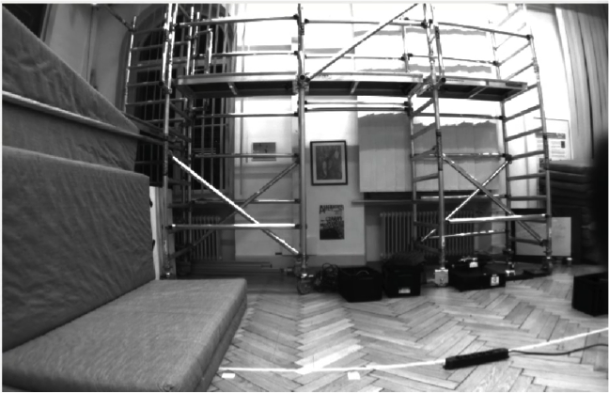
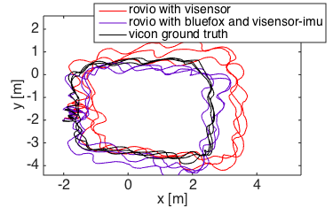
Fast dataset – Fixed Extrinsics
ROVIO and OKVIS
Time-Synchronization
Outlook
Fixing the Extrinsics can increases Rovio performance on non-timesynced Hardware

Slide 16
Outlook
ROVIO and OKVIS
Time-Synchronization
Outlook
Outlook
Rovio: Combine with „Backend“ performing a Global Optimization
Rovio: Include additional Sensorinformation (GPS, Magnetometer)
Run Rovio on embedded system with lower-quality IMU and non-timesynchronized Hardware
Run and evaluate Okvis

Slide 17
Thank you !

Slide 18
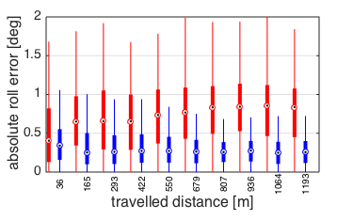
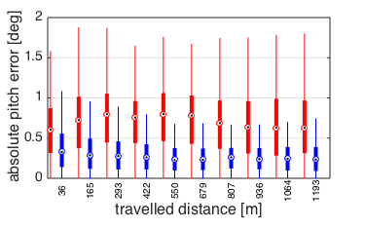
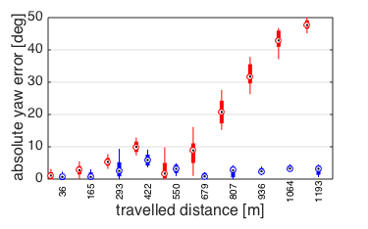
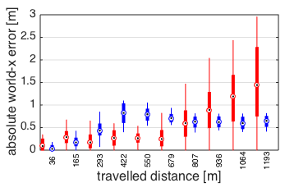
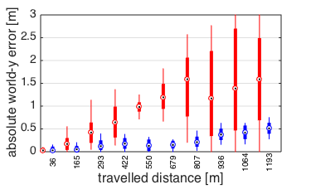
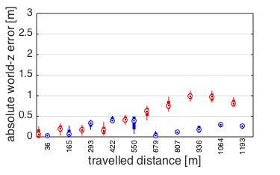
Global Accuracy – separated axes
ROVIO and OKVIS
Time-Synchronization
Outlook

Slide 19
Global Accuracy
ROVIO and OKVIS
Time-Synchronization
Outlook
Yaw Drift of Rovio 10 times higher over 1000 m
World-z Drift of Rovio 3 times higher over 1000 m

Slide 22
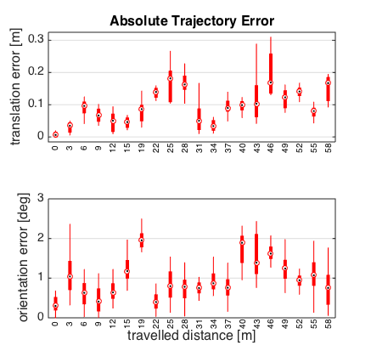
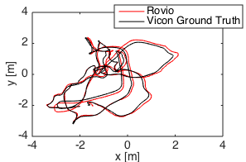
Global Accuracy – Euroc Data

Slide 23
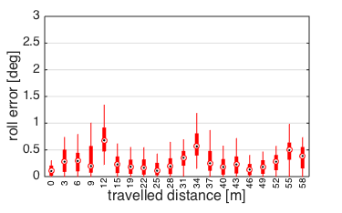
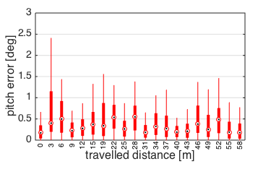
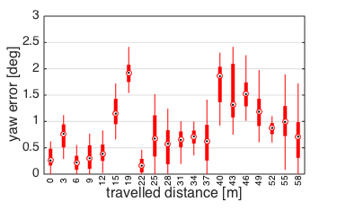
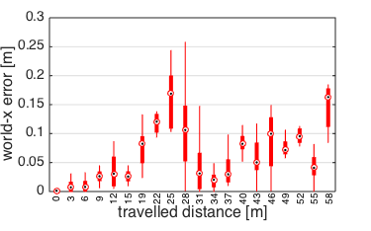
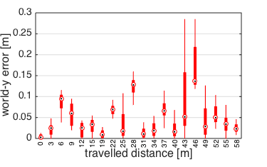
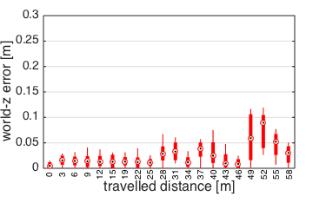
Global Accuracy – Euroc Data
AOE_Yaw = 1 deg / 50 m
ATE_Z = 5 cm / 50 m (0.1 %)

Slide 24
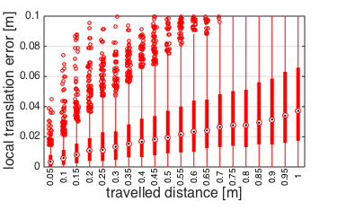
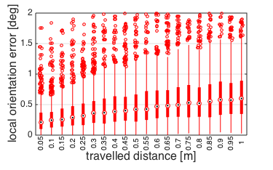
Local Accuracy – Euroc Data
RTE = 4 cm / 1 m (4 %)
ROE = 0.6° / 1 m

Slide 25
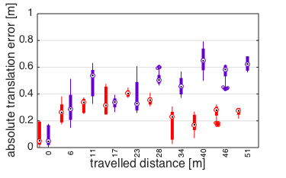
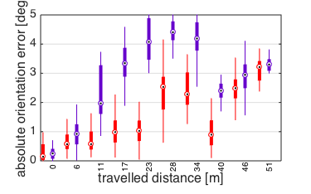
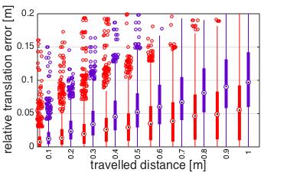
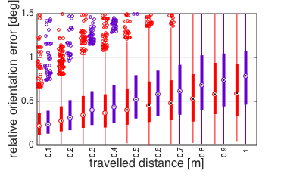
Slow Dataset
ROVIO and OKVIS
Time-Synchronization
Outlook
Dynamics: 1.5 m/s, 1 rad/s
Non-timesynchronized Hardware is able to track
Visensor performs better

Slide 26
Fast dataset
ROVIO and OKVIS
Time-Synchronization
Outlook
Fast, shaky motions
Dynamics: 2.5 m/s, 5 rad/s
Non-timesynchronized Hardware diverging

Slide 27
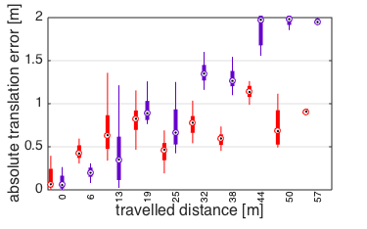
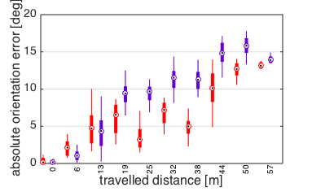
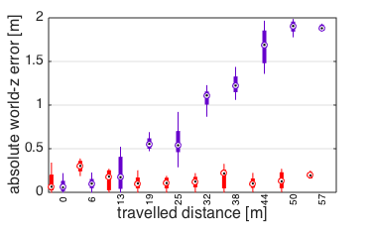
Fast dataset – Fixed Extrinsics
ROVIO and OKVIS
Time-Synchronization
Outlook
Fixing the Extrinsics on non-timesynced Hardware increases Rovio performance

Slide 28
Results – Euroc Data
Rovio and Okvis
Time-Synchronization
Outlook
 | Rovio | Okvis
Absolute Translation Error | 5 cm / 50 m | -
Absolute Orientation Error | 45 ° / 50 m | -
Absolute Yaw Error | 1 ° / 50 m | -
Absolute world-z Error | 5 cm / 50 m | -
Relative Translation Error | 4 cm / 1 m | -
Relative Orientation Error | 0.6 ° / 1 m | -
Processing Time / Frame | 10 ms | unknown, higher

Slide 29
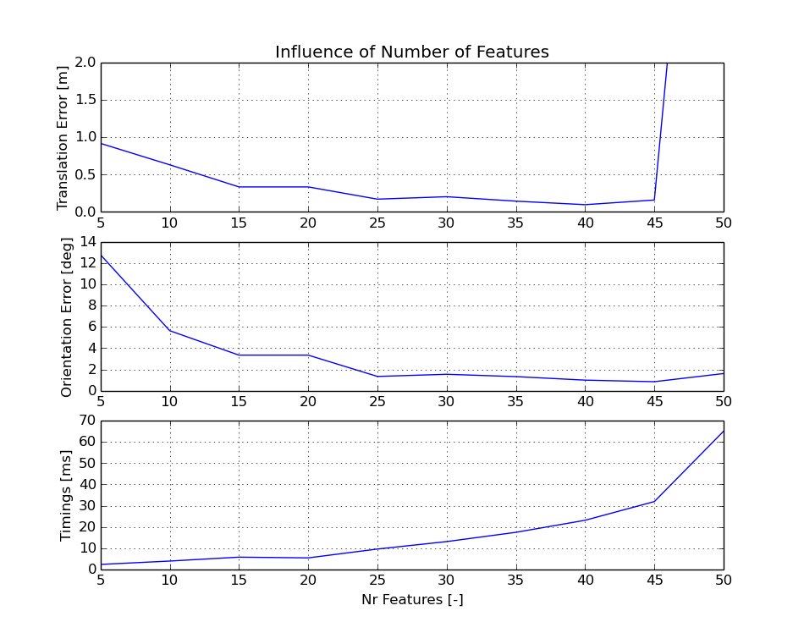
Computational Complexity / Features – Euroc Data

